Slide 2
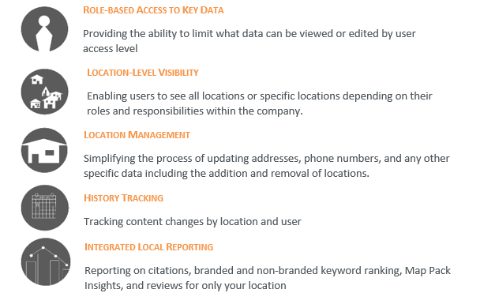
Overview

Slide 3
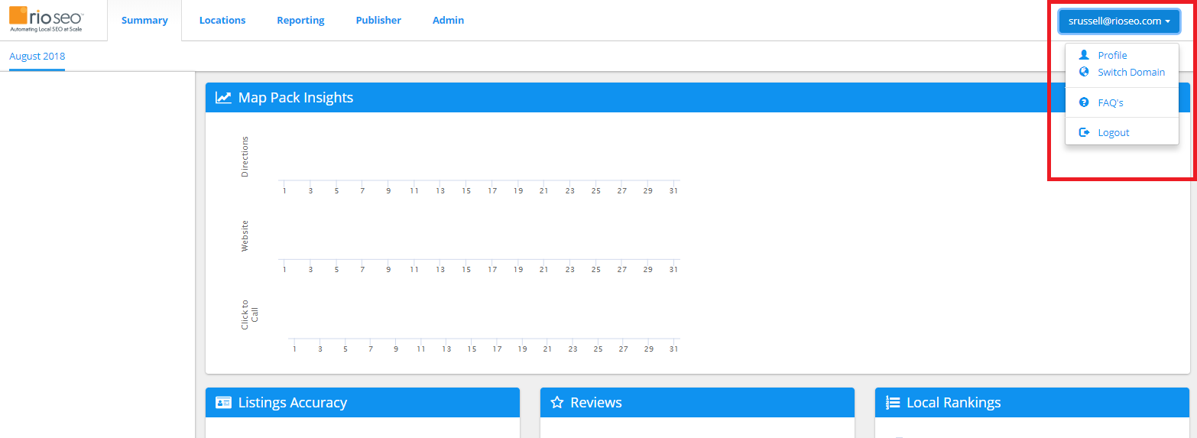
User Profile & FAQs

Slide 4
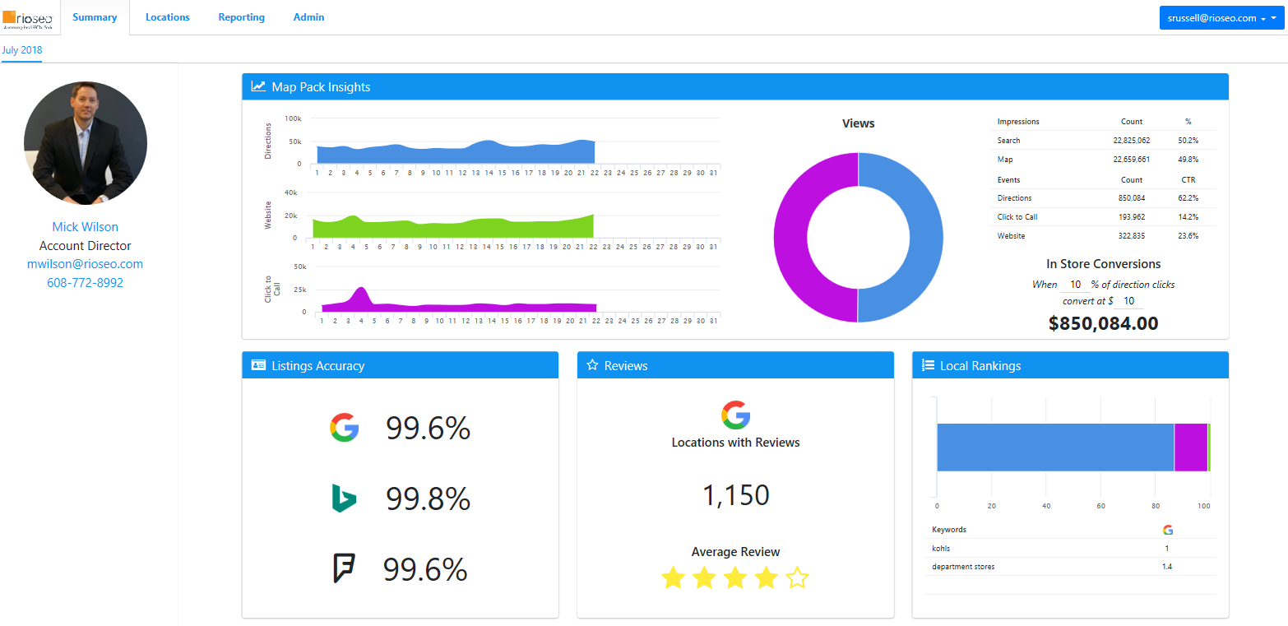
Summary Tab
Break down of user clicks
Account Director contact information
Analysis of data accuracy, comparing data on file with data published on listings
Where your locations appear in the Search Engine Results Pages of Google
Total reviews on Google along with average review star rating

Slide 5
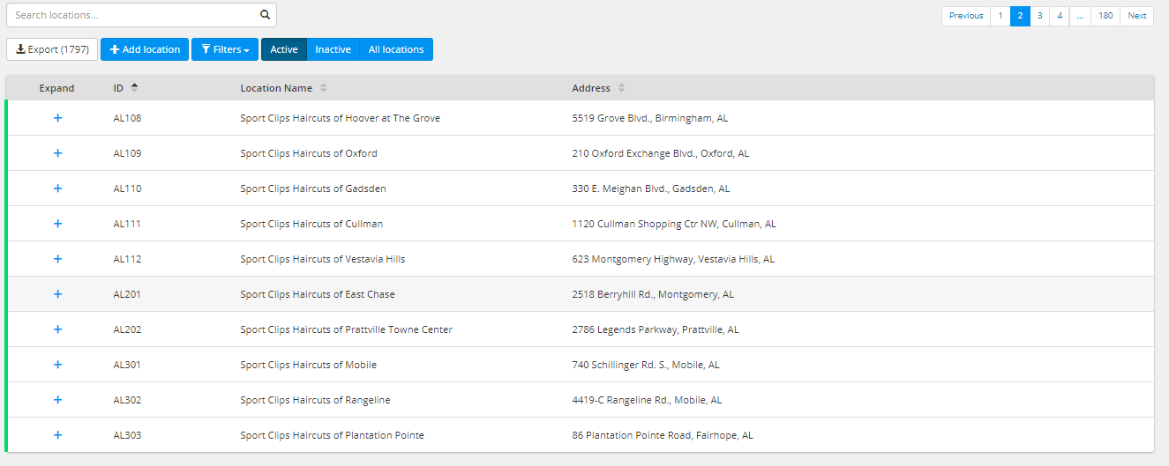
Location Management

Slide 6
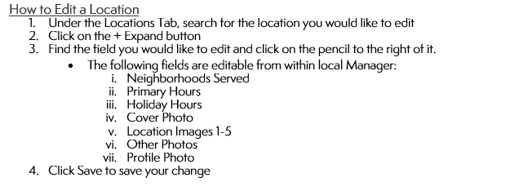
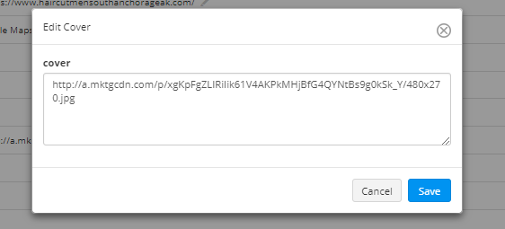
Editing A Location

Slide 7
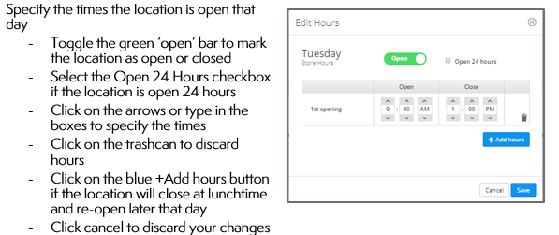
Updating Primary Hours

Slide 8
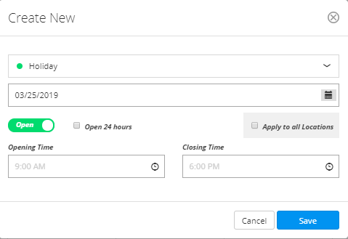
Adding Holiday Hours

Slide 9
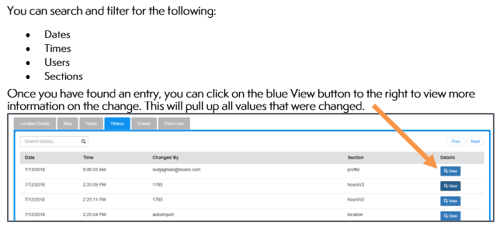
Change History

Slide 10
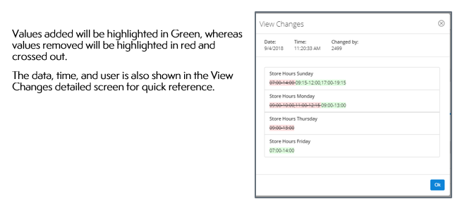
Change History – Continued

Slide 11
Updating Your Business Listings
API Connectivity – Near real-time updating:

Slide 12
Local Reporting

Slide 13
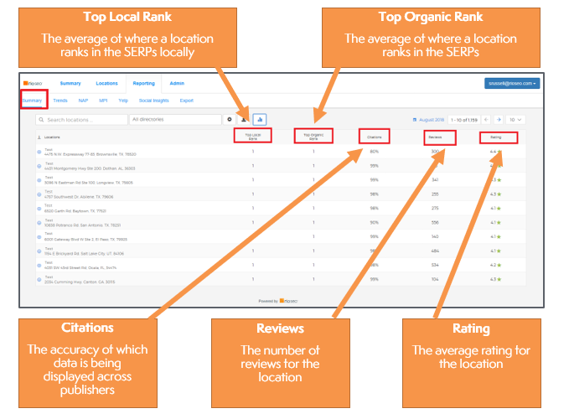
Summary
Displays a quick Local Reporting summary of all locations including top local ranking, top organic ranking, citations, ratings, and reviews.

Slide 14
Summary – Continued

Slide 15
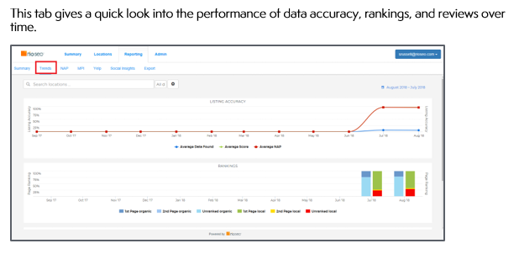
Trends

Slide 16
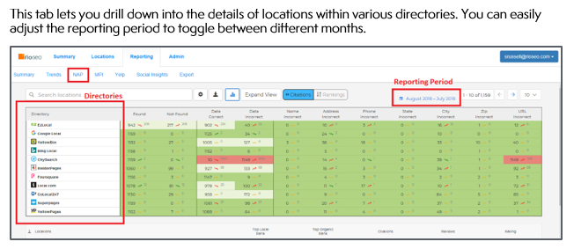
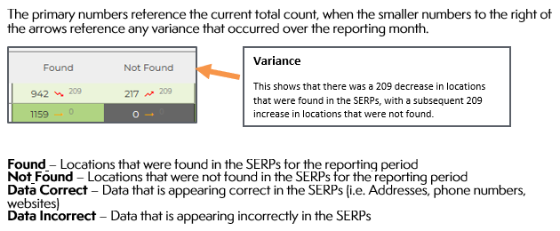
NAP (Name-Address-Phone)

Slide 17
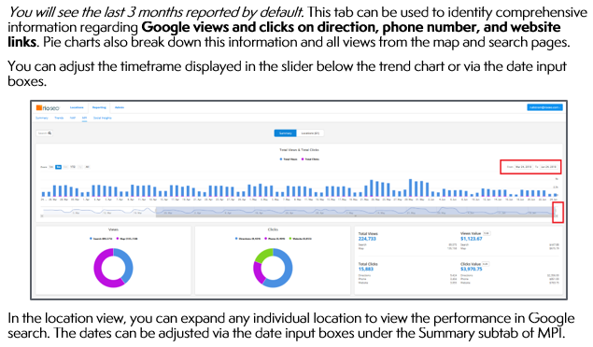
MPI (Map Pack Insights)

Slide 18
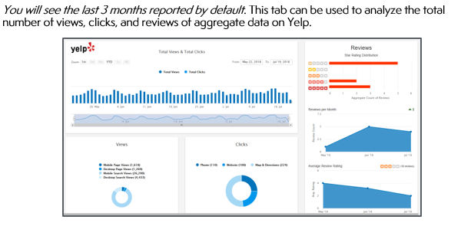
Yelp

Slide 19
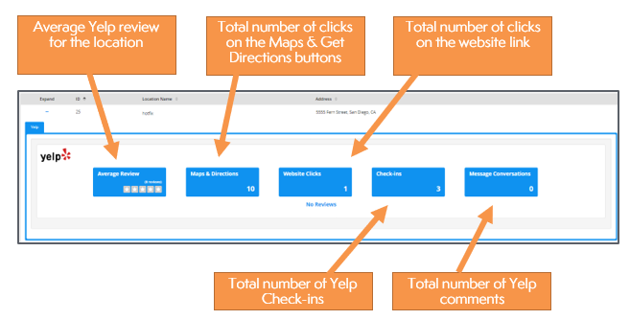
Yelp – Continued

